Slide 1


Slide 2

iDev Solutions
Integrated Development Solutions provides innovative out of the box technological support and services that is reliable and cost-effective for small or large companies.
Our software development team operates with highly skilled, enterprising and multidisciplinary professionals from various spheres of expertise.

Slide 3
introduction
The University Management System (UMS) is a comprehensive innovative system for managing educational office activities of University.
Modules in UMS are fully integrated.
An unlimited number of users can be defined with in UMS.
UMS is a multi-divisional, multi-departmental and cost-center based suite of applications, which will practically cover the entire area of operations of the University.
The UMS is built using Microsoft .NET technology, driven at the back-end by using Microsoft SQL Server, which gives the application more power in security, scalability and maintainability.

Slide 4
Product Highlights
Manage multiple colleges comprising of multiple departments
Period-wise course catalogue permits to maintain different catalogue
Streamlined registration and admission activities
Organized college management involved in scheduling program, course and syllabus details
Define multiple fee policies for different year levels.
Supports sponsors and installments in fee management

Slide 5
Core Functionalities
University Management
Define and manage various programs and courses offered by the institutions
Supports by semester system
Maintain different schedules for programs/courses being conducted at various colleges
Supports templates for admission, exam, fees and grading techniques

Slide 6

Server Hardware Requirements
Intel Core 2 Duo or any other compatible processor
1 GB RAM or higher
Minimum of 40 GB HDD space

Slide 7

Server Software Requirements
Microsoft Windows 2003 Small Business Server or higher
RDBMS (Microsoft SQL Server 2005 or higher)

Slide 8
Client Hardware Requirements
Intel Pentium IV 300 MHz or higher/any other compatible processor
256MB RAM or higher
Multimedia installed
Display resolution 1024x768 pixels, recommended
Minimum 2GB HDD space

Slide 9
Client Software Requirements
Microsoft Windows XP
Internet Explorer 5.0 or higher
Macromedia flash player

Slide 10
Ums modules
University Management System

Slide 11
UMS Modules
Academic Components
Room Management & Subject Offering
ID Acquisition
Business and Finance Components
Cashiering Module
School Fee Module
Administrative Components
Employee Information System
Transaction Log
Teacher Loading
Academic Transaction
Collection Reports

Slide 12
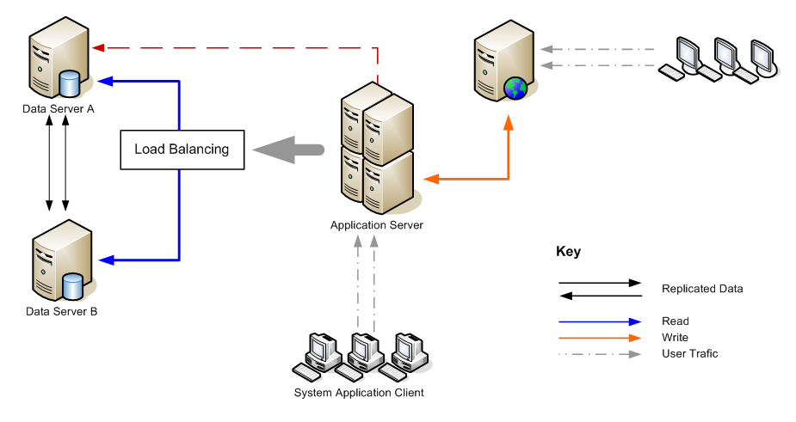
Typical UMS Setup

Slide 13
Ums SCREEN SHOTS
University Management Solution

Slide 14
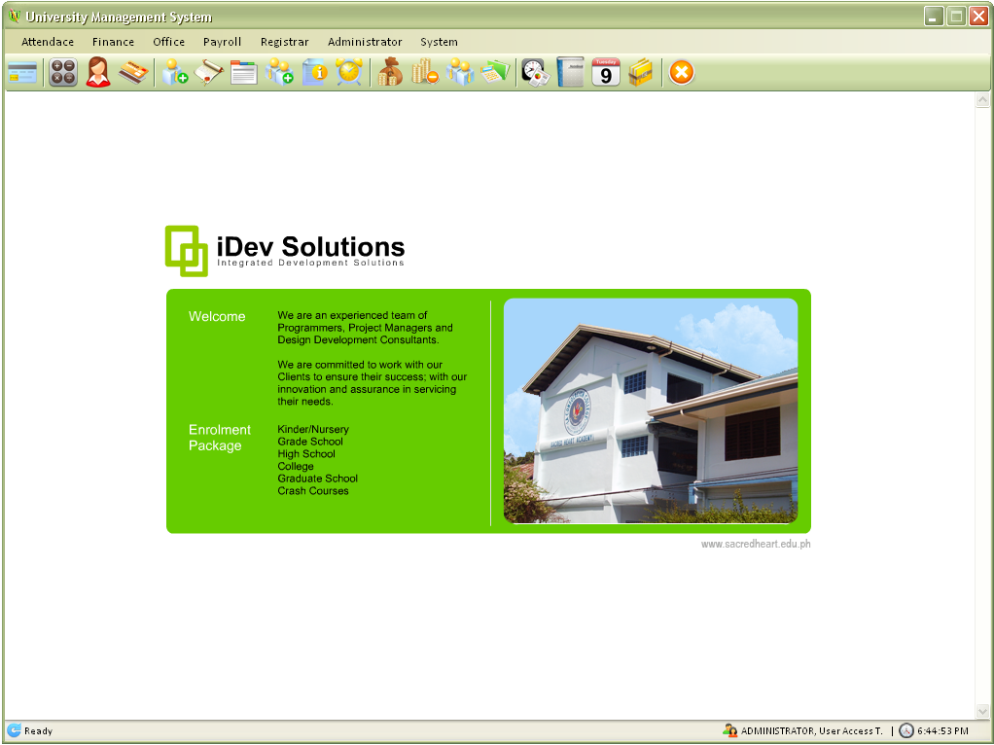
Main Window
This screen shows the main window of the UMS application.

Slide 15
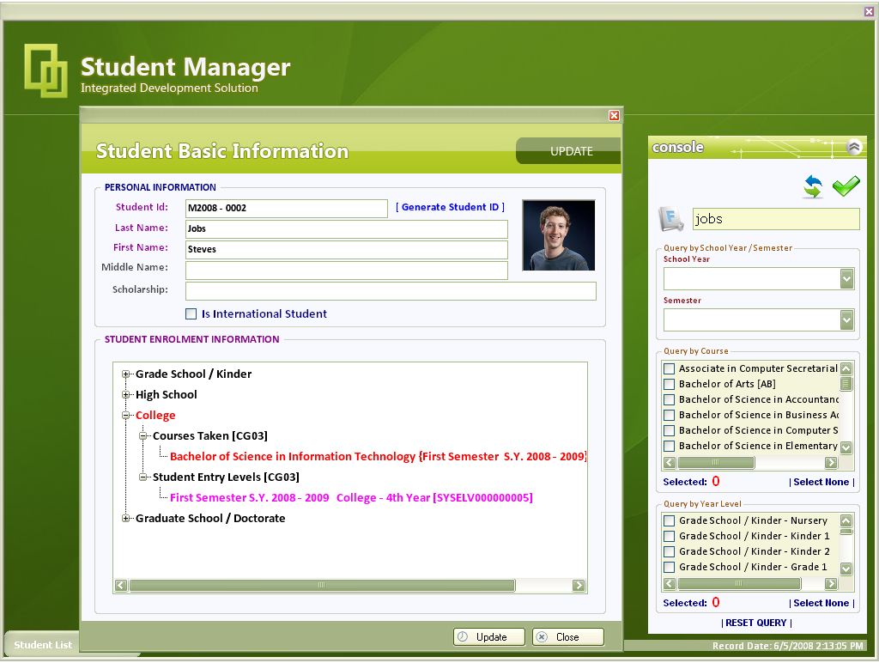
Student Manager
Search students using various search criteria
View student enrolment history
The student manager module handles student registration process. Along with student information, and manage subject offering.

Slide 16
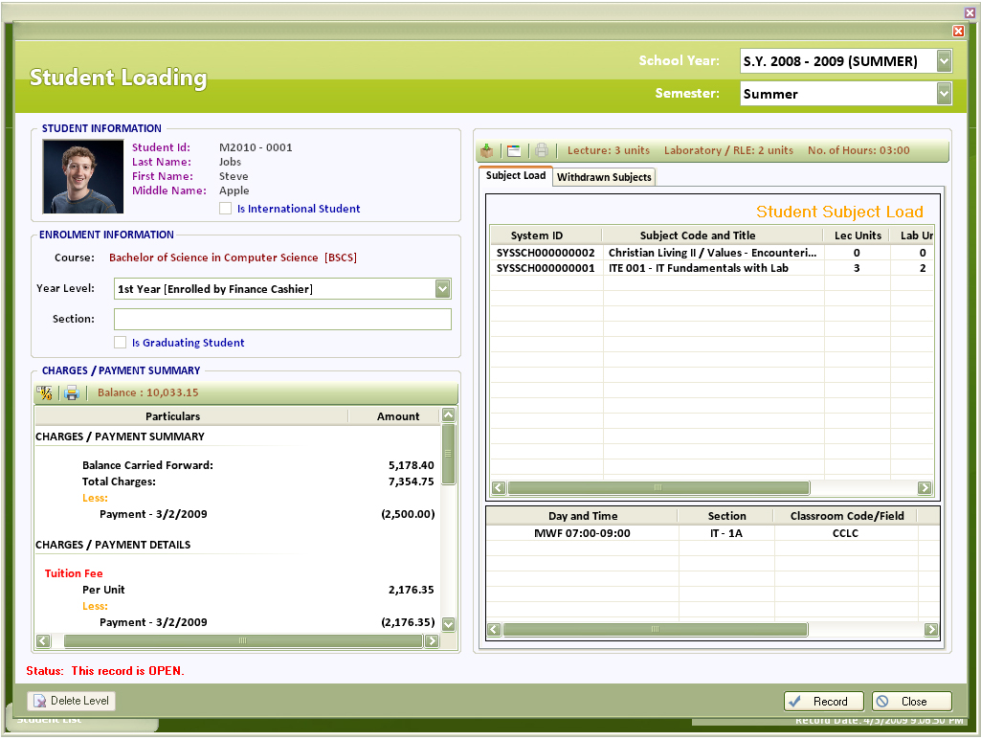
Student Loading
Student information
Student subject load
Current charges information
This screen allows you to manage subject offering (max. students allowed, tuition fee, assign class professor).

Slide 17
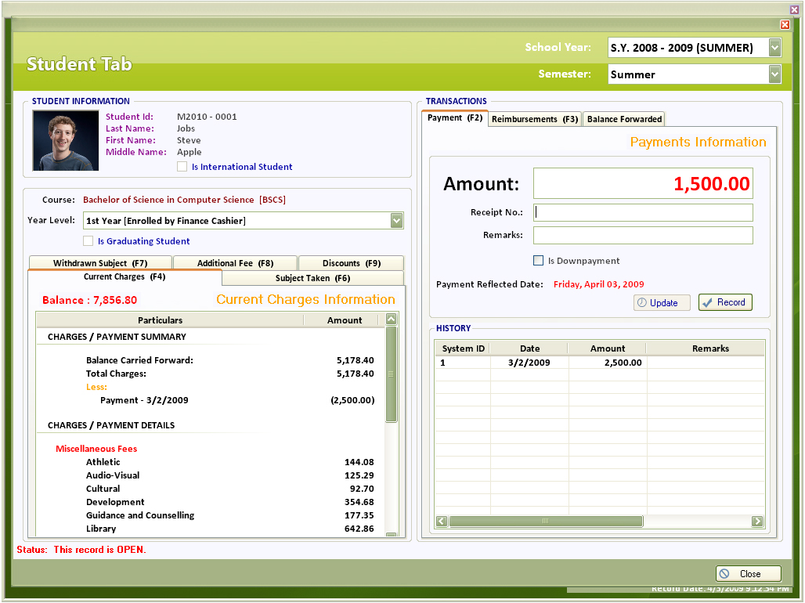
Cashiering
Transactions
This screen allows you to input tuition fee rates for each year level which will be printed in details in the student enrolment record and generates statement of accounts and clearances based on major exam schedules defined by the registrar.

Slide 18
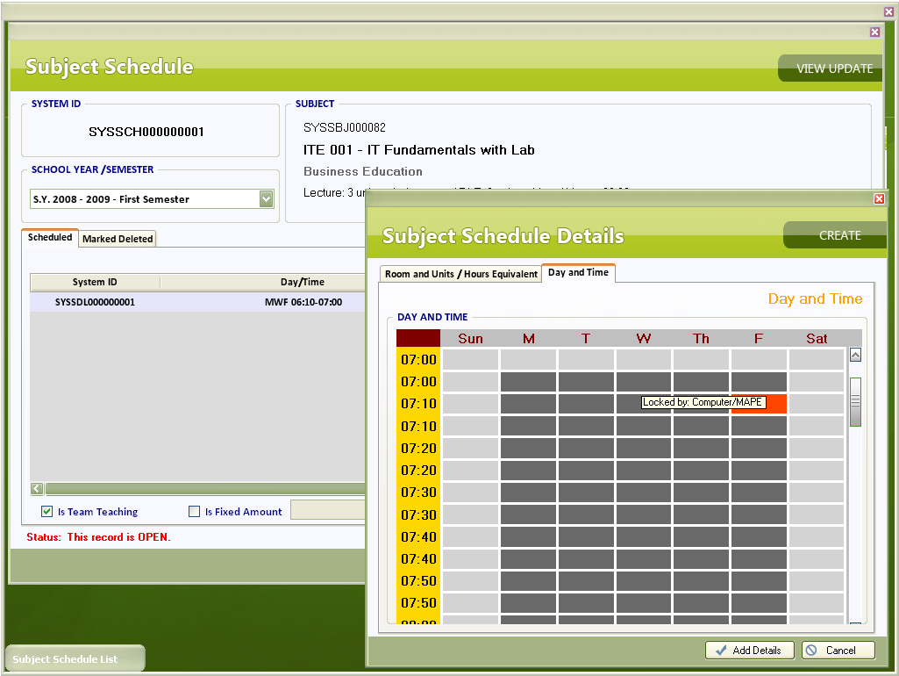
Subject Scheduling
A dynamic time scheduling
This screen shows adding/dropping of subjects made easy.

Slide 19
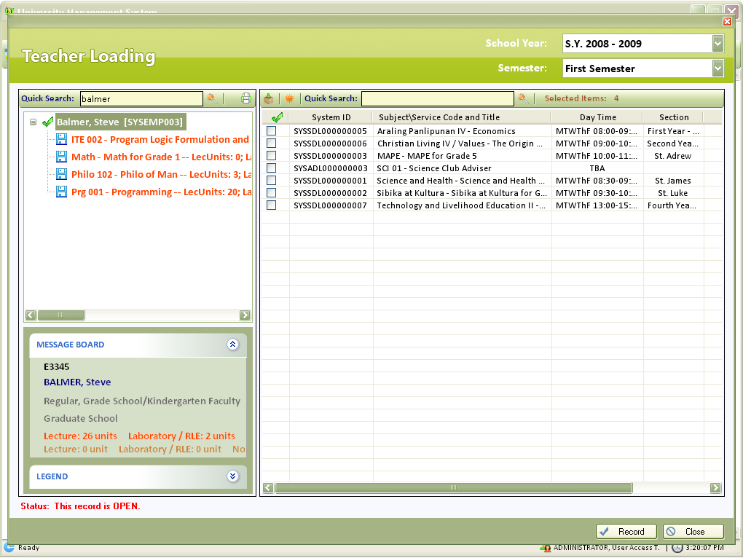
Teacher Loading
Teacher load
List of subjects offered by semester
This modules enables user to add, delete or edit teacher subject loading.

Slide 20
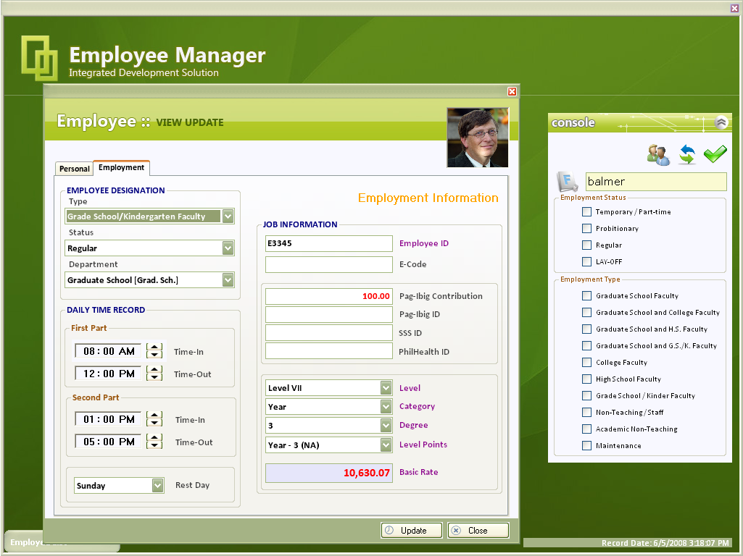
Employee Manager
Search employees using various search criteria
Employee information
This module enables the user to add, delete or edit employee details.

Slide 21
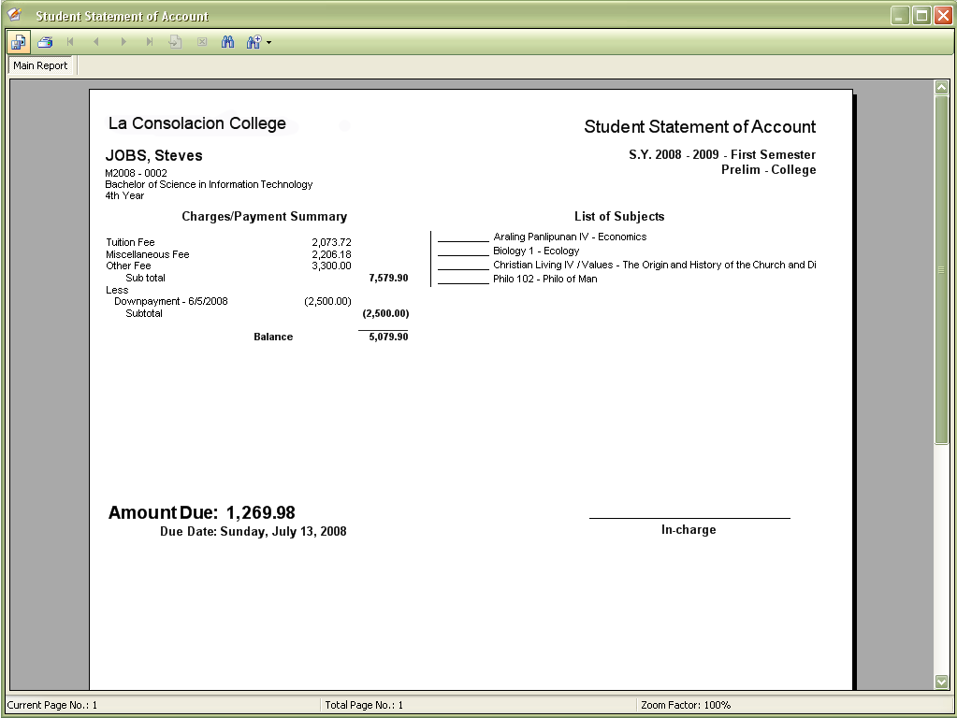
Student Statement of Accounts
Charges payment summary
List of subjects taken
This screen shows the student billing report with list of subjects taken.

Slide 22
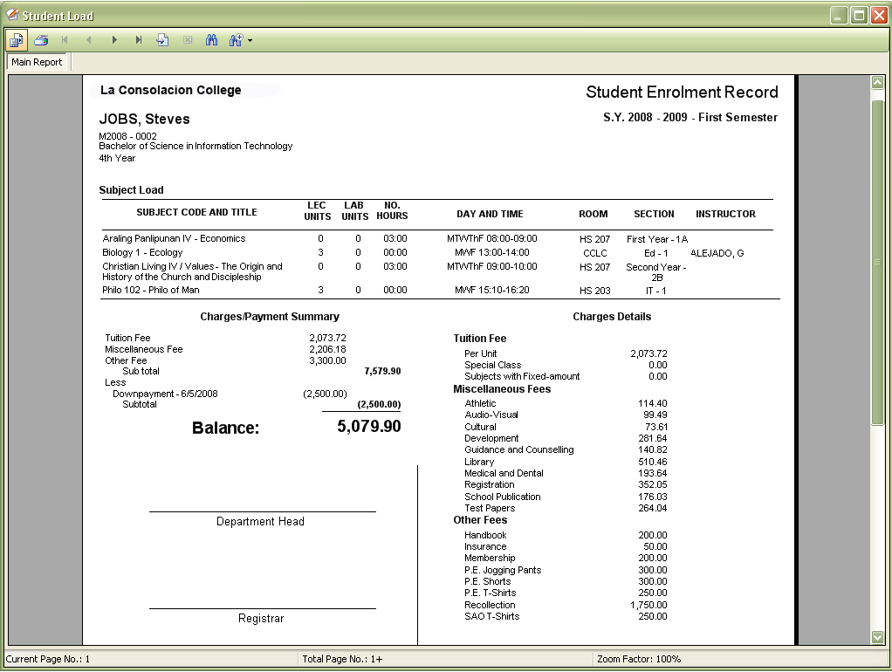
Student Loading Reports
Subject load
Charges payment summary
Charges details
This screen shows statement of accounts and clearances based on major exam schedules defined by the registrar.

Slide 23
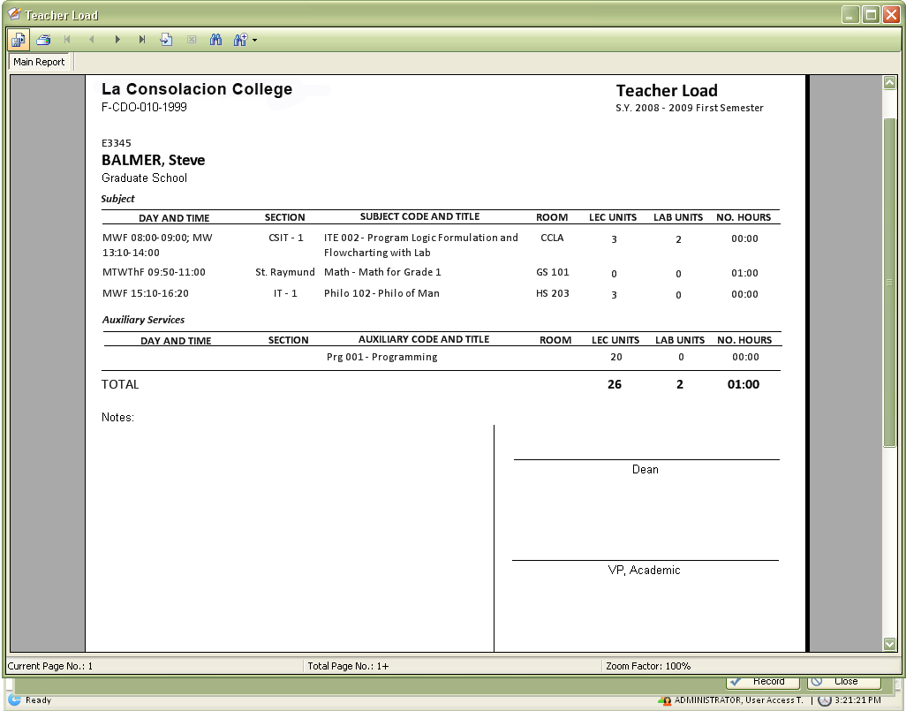
Teacher Loading Reports
Subject load
This screen contains information on the teacher’s subject loading.

Slide 24
Security
System wide security to address privacy & security compliance with SQL Server.
Achieve a more secure deployment. SQL Server 2005 provides rich security features to protect data and network resources.
User password controlled and administrator controlled modular access.

Slide 25
UMS is the right choice for you
Here is why:
Proven to be stable
FREE maintenance and updates
A Multi-tier Architecture System
It's WINDOWS based application
Notes:
s

Slide 26
Client Support
Onsite initial staff training and installation support.
Product version updates provided on as needed basis.
Support and maintenance services provided on demand.

Slide 27
Conclusion
UMS is a completely secure, confidential, interactive management system for your school. Composed of over 8 modules integrated to automate the flow of information and get your tasks done with just a few clicks of the mouse and developed using the most popular windows-based technologies. It is easy to setup and deploy!

Slide 28
Contact Us
AGTI Printing Press Bldg
L. Rovira Rd., Interior
Bantayan, Dumaguete City 6200
Negros Oriental
Philippines
(035) 225-2501
(look for Ms. Maricar Batadlan)
Judyll Mark T. Agan, MIT
Solution Developer/Proprietor
Email : judyll.agan@gmail.com
Yahoo ID : judyll_agan@yahoo.com
Skype : judyllagan
Mobile : 0915.405.5748
Home : (035) 422.3893
Francis Raymund Delfino
Junior Programmer
Email : francisdelfino@gmail.com
Yahoo ID : ansing_19@yahoo.com
Skype : francis_delfino
Mobile : 0922.381.3397
Beaumont Jo, MIT
Web developer
Email : beumont_jo@yahoo.com
Yahoo ID : beaumont_jo
Mobile : 0919.731.5325

